Slide 1

Cloud Fundamentals: Understanding the Core Concepts and Services
Exploring essential concepts of cloud computing
Notes:
--- Cloud computing has transformed how we store, manage, and process data. In this presentation, we will explore essential concepts of cloud computing, including its service models and key features.

Slide 2
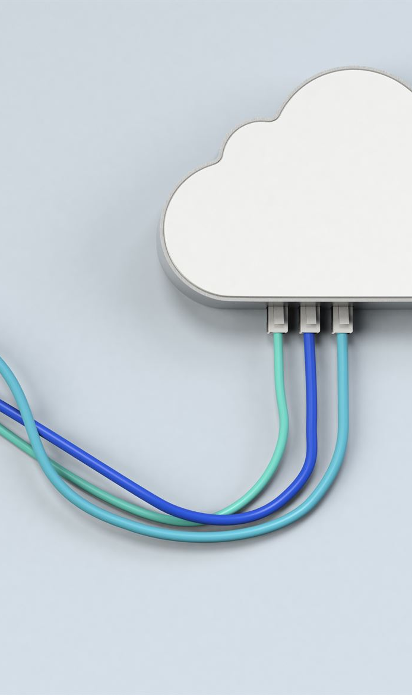
Agenda Overview
Introduction to Cloud Computing
Key Cloud Service Models
Infrastructure as a Service (IaaS)
Platform as a Service (PaaS)
Software as a Service (SaaS)
Identity as a Service (IDaaS)
Notes:
We will start with an introduction to cloud computing, covering its definition, history, benefits, and challenges. Then, we will delve into the key service models: IaaS, PaaS, SaaS, and IDaaS, discussing their definitions, use cases, and advantages and disadvantages.

Slide 3
Introduction to Cloud Computing
Notes:
Cloud computing is a paradigm shift in how IT resources are allocated and consumed. It allows users to access computing power, storage, and applications over the internet, fostering greater flexibility and efficiency.

Slide 4
Definition and Characteristics of Cloud Computing
On-Demand Self-Service
Users can provision computing resources automatically without requiring human interaction with service providers.
Broad Network Access
Cloud services are accessible over the network from various devices, including smartphones, tablets, and computers.
Resource Pooling
Providers pool resources to serve multiple consumers using a multi-tenant model, maximizing efficiency and flexibility.
Rapid Elasticity
Resources can be rapidly and elastically provisioned to quickly scale according to demand.
Measured Service
Cloud systems automatically control and optimize resource usage, providing transparency for both providers and consumers.
Notes:
Cloud computing refers to the delivery of computing services over the internet. Key characteristics include on-demand self-service, broad network access, resource pooling, rapid elasticity, and measured service.

Slide 5
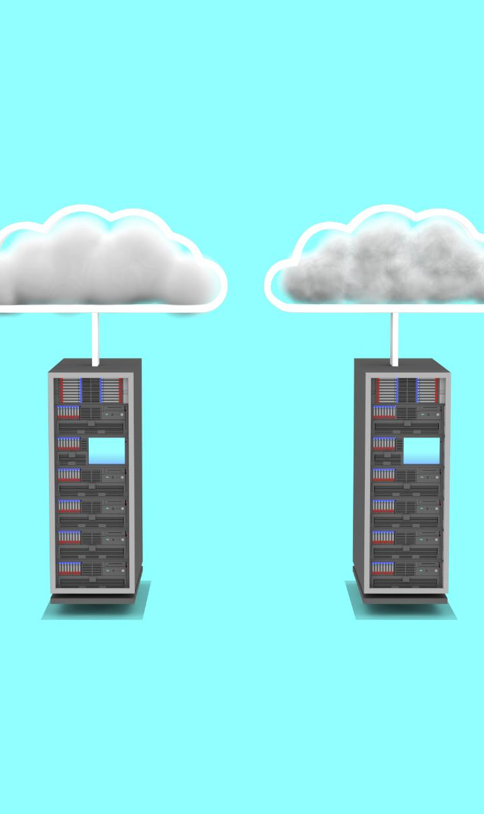
History and Evolution of Cloud Computing
Mainframe Computing Origins
Cloud computing traces its roots back to mainframe computing in the 1960s, where centralized computing power was utilized.
Advent of Virtualization
The emergence of virtualization technologies in the 2000s was a key milestone that enabled the development of modern cloud services.
Modern Cloud Services
Today, cloud computing encompasses a wide range of services, from storage to software, accessible over the internet.
Notes:
The concept of cloud computing has evolved over several decades, originating from mainframe computing in the 1960s. The advent of virtualization in the 2000s paved the way for modern cloud services as we know them today.

Slide 6
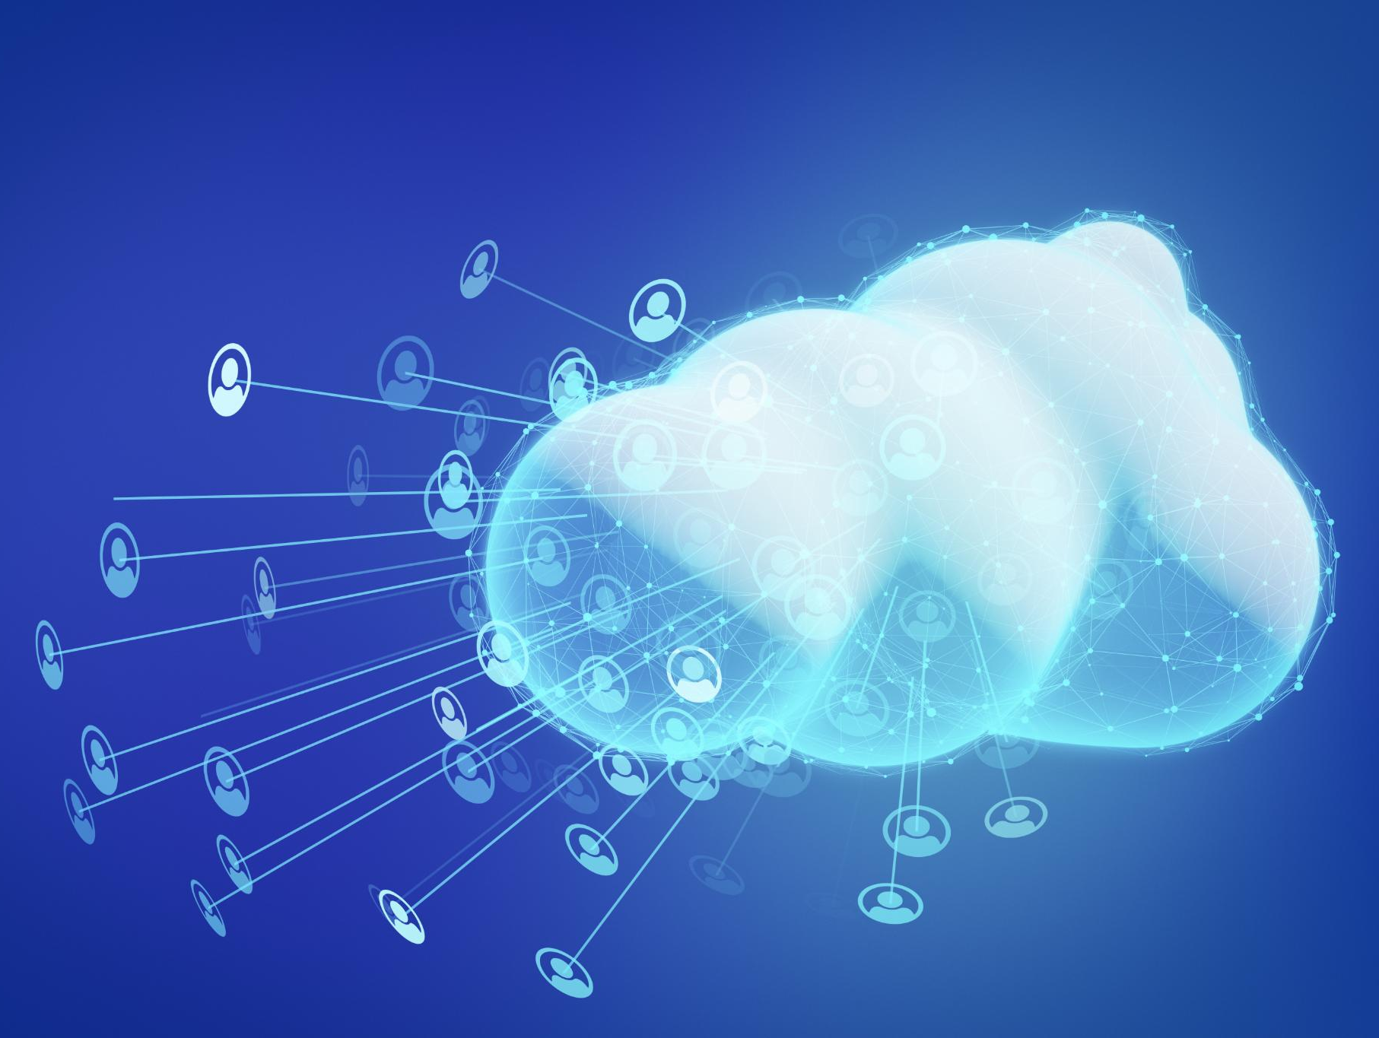
Benefits and Challenges of Cloud Adoption
Benefits of Cloud Adoption
Cloud computing offers significant benefits like cost savings, improved scalability, and enhanced collaboration among teams.
Security Concerns
One of the major challenges of cloud adoption is security concerns, which can put sensitive data at risk.
Compliance Issues
Organizations must navigate compliance issues when adopting cloud services to ensure they meet industry regulations.
Potential Downtime
Cloud services can experience potential downtime, which may affect business operations and service availability.
Notes:
Adopting cloud computing provides benefits such as cost savings, scalability, and increased collaboration. However, challenges include security concerns, compliance issues, and potential downtime.

Slide 7
Key Cloud Service Models
Notes:
Cloud services are typically categorized into three main models: IaaS, PaaS, and SaaS. Each model offers different levels of control, flexibility, and management responsibilities.

Slide 8
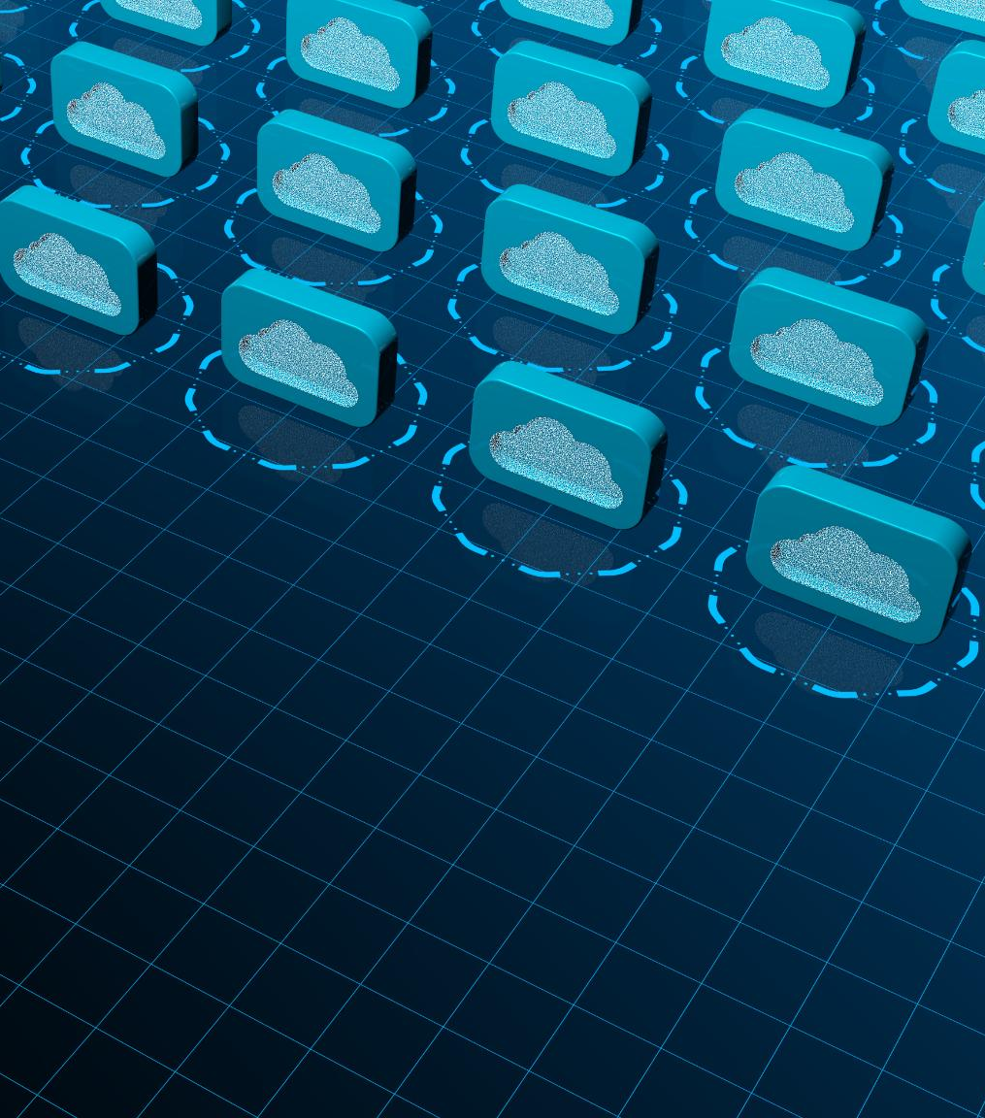
Infrastructure as a Service (IaaS)
Virtualized Computing Resources
IaaS offers virtualized servers, storage, and networking resources over the internet, enabling efficient resource management.
Flexibility and Scalability
This model provides businesses with the flexibility to scale resources up or down based on their demand.
Notes:
IaaS provides virtualized computing resources over the internet, allowing users to rent servers, storage, and networking. This model offers flexibility and scalability for businesses.

Slide 9
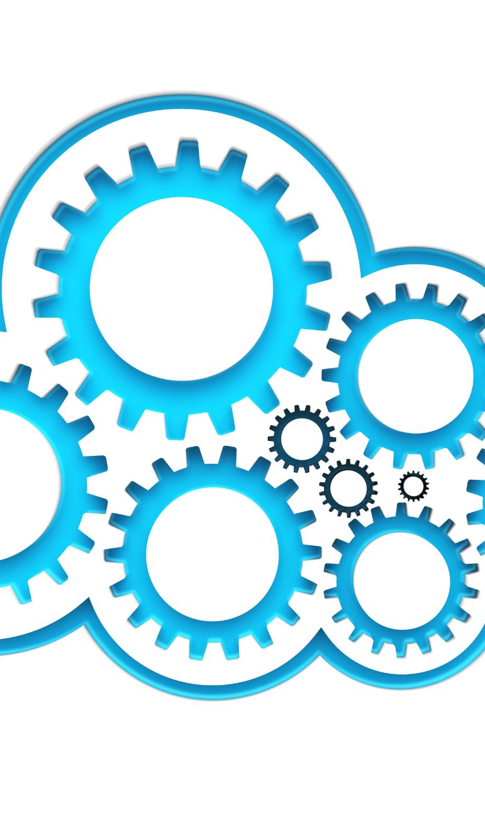
Platform as a Service (PaaS)
Simplified Development Process
PaaS simplifies the development process by providing built-in tools and services, allowing developers to focus on application development.
Infrastructure Management
Developers can avoid the complexities of managing underlying infrastructure with PaaS, as it abstracts these details.
Scalability and Flexibility
PaaS offers scalability and flexibility for application deployment, allowing businesses to adapt quickly to changing demands.
Notes:
PaaS provides a platform allowing developers to build, deploy, and manage applications without the complexity of managing the underlying infrastructure. It streamlines the development process.

Slide 10
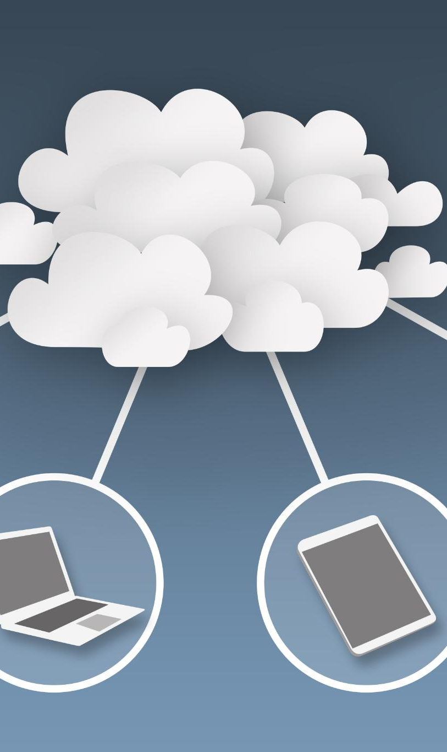
Software as a Service (SaaS)
Convenient Access
SaaS allows users to access software applications from any device with an internet connection, ensuring flexibility and convenience.
Subscription Model
SaaS operates on a subscription basis, which can be more cost-effective than traditional software purchases, providing continuous access and updates.
No Installation Required
With SaaS, users do not need to install software on their devices, which simplifies the process and saves time.
Notes:
SaaS delivers software applications via the internet on a subscription basis. Users can access applications from any device without installation, making it convenient and cost-effective.

Slide 11
Infrastructure as a Service (IaaS)
Notes:
IaaS offers several benefits, including cost-effectiveness and scalability. However, it also has downsides, such as requiring technical expertise and potential security risks related to data management.

Slide 12

Definition and Key Features
What is IaaS?
Infrastructure as a Service (IaaS) delivers essential computing resources over the internet, including virtual machines and storage solutions.
Elasticity
IaaS offers elasticity, allowing users to scale resources up or down based on demand, ensuring efficiency and cost-effectiveness.
On-Demand Resources
With IaaS, users can access computing resources on-demand, promoting flexibility and agility in resource management.
Control Over OS
IaaS provides users with control over the operating system, allowing for customization and management of virtual resources.
Notes:
IaaS provides essential computing resources such as virtual machines, storage, and firewalls over the internet. Key features include elasticity, on-demand resources, and control over the operating system.

Slide 13
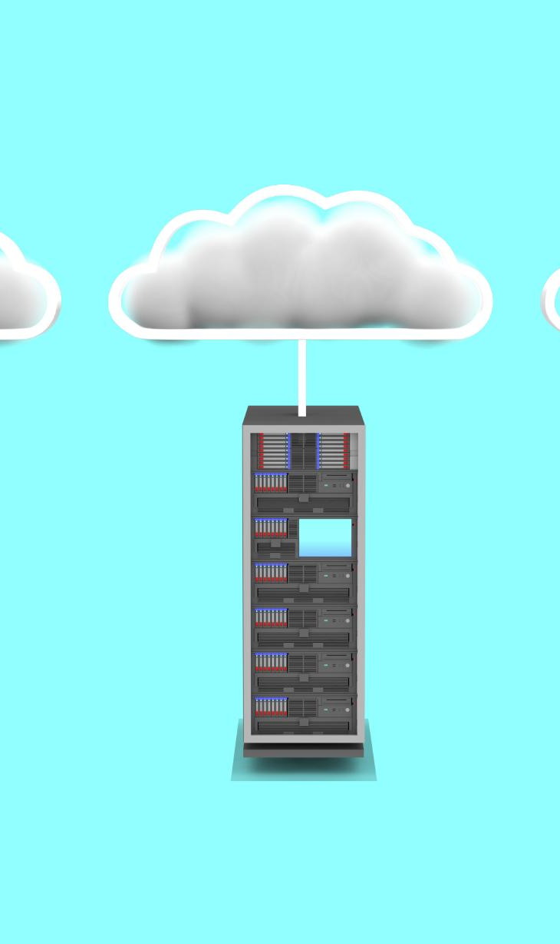
Use Cases and Examples
Website Hosting
IaaS platforms provide scalable resources for hosting websites, ensuring high availability and performance for users.
Data Backup and Recovery
IaaS solutions offer efficient data backup and recovery options, allowing businesses to safeguard their critical information.
High-Performance Computing
IaaS enables organizations to leverage high-performance computing resources for complex computations and data analysis.
Notes:
Common use cases for IaaS include website hosting, data backup and recovery, and high-performance computing. Examples of IaaS providers are Amazon Web Services (AWS) and Microsoft Azure.

Slide 14
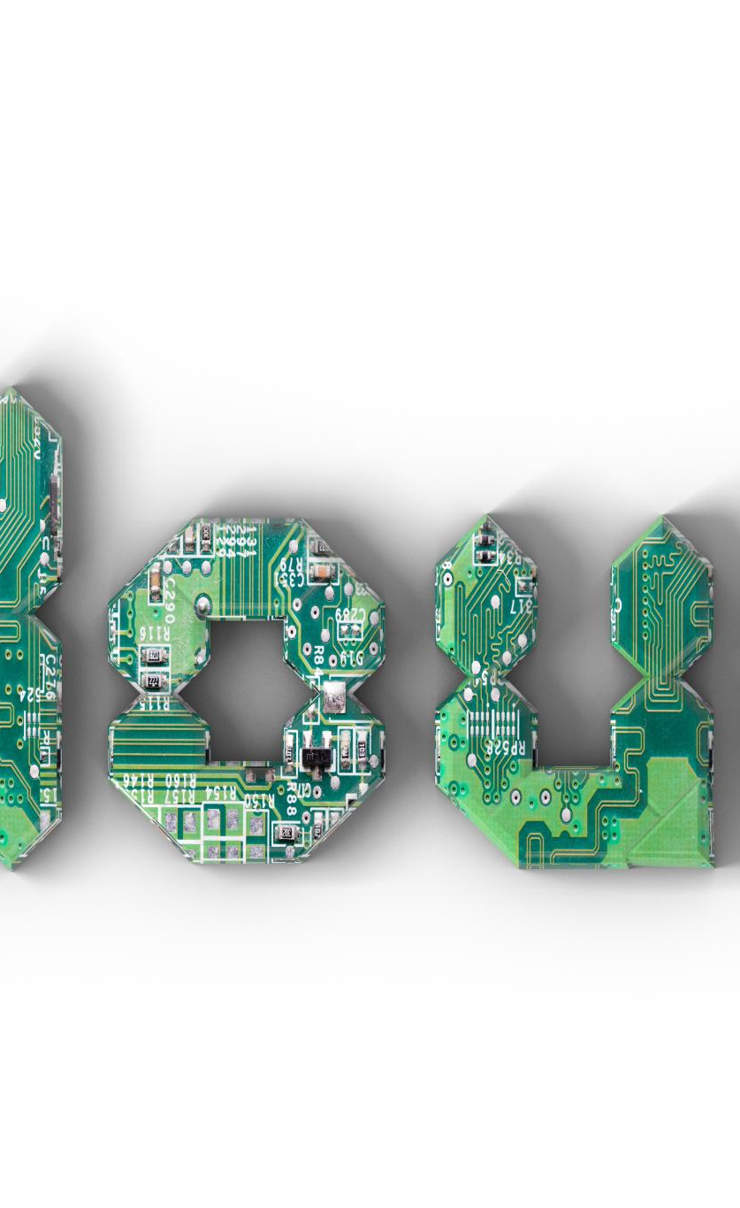
Advantages and Disadvantages
Advantages of IaaS
IaaS offers significant advantages like scalability and flexibility, allowing businesses to grow and adapt quickly.
Cost Reduction
By reducing physical hardware costs, IaaS enables companies to allocate resources more efficiently and invest in other areas.
Disadvantages of IaaS
Despite its benefits, IaaS comes with challenges like managing complex infrastructure and addressing potential security vulnerabilities.
Notes:
The advantages of IaaS include scalability, flexibility, and reduced physical hardware costs. Disadvantages may include managing complex infrastructure and potential security vulnerabilities.

Slide 15
Platform as a Service (PaaS)
Notes:
PaaS offers a complete development environment in the cloud, enabling developers to build applications without managing underlying hardware or software layers.

Slide 16
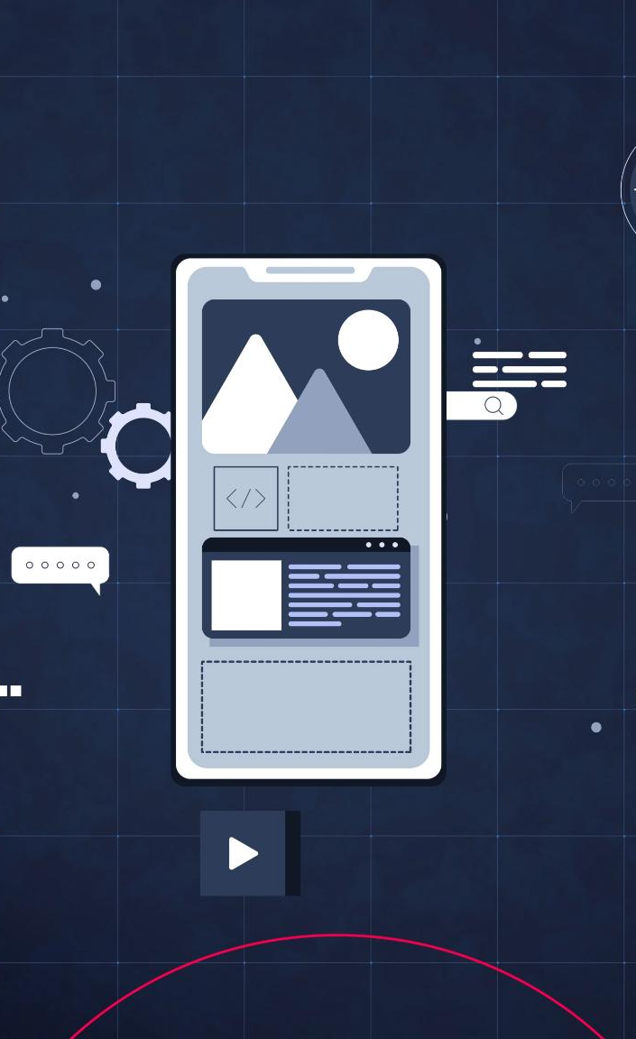
Definition and Key Features
Framework for Developers
PaaS offers a comprehensive framework that allows developers to build and deploy applications efficiently.
Built-in Software Components
One of the key features of PaaS is the availability of built-in software components that streamline the development process.
Development Tools and Middleware
PaaS includes essential development tools and middleware that help simplify the app development lifecycle.
Notes:
PaaS provides a framework for developers to create applications. Key features include built-in software components, development tools, and middleware to simplify app development.

Slide 17

Use Cases and Examples
Web Application Development
PaaS provides a scalable platform for developing web applications efficiently, reducing time and resource investment.
API Development
PaaS is ideal for creating and managing APIs, enabling seamless integration and communication between services.
Microservices Architecture
PaaS supports the development of microservices, allowing for modular and independent application components.
Notes:
PaaS is ideal for developing web applications, APIs, and microservices. Popular PaaS providers include Google App Engine and Heroku.

Slide 18
Advantages and Disadvantages
Faster Development
PaaS allows developers to build applications more quickly due to pre-built tools and environments, streamlining the development process.
Reduced Coding Complexity
With PaaS, developers can focus more on application logic rather than infrastructure management, reducing overall coding complexity.
Built-in Security Features
PaaS often comes with pre-configured security features, helping to safeguard applications and reduce security overhead for developers.
Vendor Lock-in
A significant disadvantage is vendor lock-in, where migrating away from a PaaS provider can be challenging and costly.
Limited Flexibility
PaaS can offer limited flexibility in terms of technology stacks and customization, which may restrict some development needs.
Notes:
PaaS advantages include faster development, reduced coding complexity, and built-in security features. However, disadvantages may include vendor lock-in and limited flexibility.

Slide 19
Software as a Service (SaaS)
Notes:
SaaS is a software distribution model where applications are hosted in the cloud and accessed via the internet, eliminating the need for local installation.

Slide 20
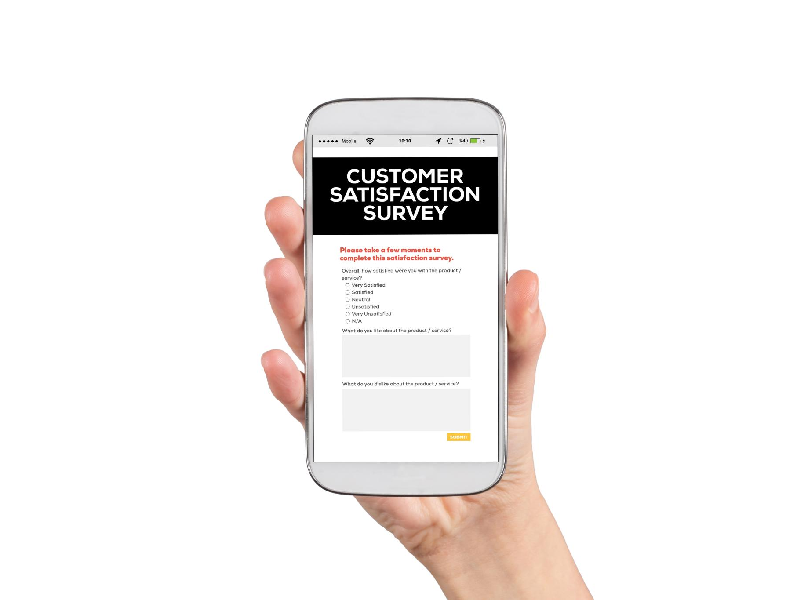
Definition and Key Features
Accessibility
SaaS applications can be accessed from any device with internet connectivity, promoting flexibility for users.
Subscription-Based Pricing
SaaS typically operates on a subscription-based pricing model, allowing users to pay for only what they use.
Automatic Updates
Automatic updates ensure users always have access to the latest features and security improvements without manual intervention.
User-Friendly Interfaces
SaaS applications are designed with user-friendly interfaces that enhance the user experience and ease of use.
Notes:
SaaS applications are accessible from any device with internet connectivity. Key features include subscription-based pricing, automatic updates, and user-friendly interfaces.

Slide 21

Use Cases and Examples
Collaborative Tools
SaaS provides various collaborative tools that enhance teamwork and communication in organizations, enabling remote work and real-time collaboration.
Customer Relationship Management (CRM)
CRM software as a service helps businesses manage customer interactions and data efficiently, improving customer satisfaction and sales.
Enterprise Resource Planning (ERP)
ERP solutions streamline business processes by integrating various departments, providing a comprehensive view of organizational performance.
Notes:
SaaS is commonly used for collaborative tools, customer relationship management (CRM), and enterprise resource planning (ERP). Examples include Salesforce and Microsoft 365.

Slide 22

Advantages and Disadvantages
Cost Savings
One of the primary advantages of SaaS is the cost savings it offers, reducing the need for expensive hardware and software purchases.
Accessibility
SaaS applications are accessible from anywhere with an internet connection, providing flexibility and convenience for users.
Data Security Concerns
Despite its advantages, SaaS poses data security challenges, as sensitive information is stored off-site on third-party servers.
Reliance on Service Provider
Users must rely on the service provider's uptime and reliability, which can affect business operations if there's an outage.
Notes:
Advantages of SaaS include cost savings, accessibility, and ease of use. However, challenges include data security concerns and reliance on the service provider's uptime.

Slide 23
Identity as a Service (IDaaS)
Notes:
IDaaS provides identity and access management in the cloud, enabling organizations to manage user identities securely and efficiently.

Slide 24

Definition and Key Features
Single Sign-On (SSO)
Single Sign-On (SSO) allows users to access multiple applications with one set of login credentials, improving user experience.
Multi-Factor Authentication (MFA)
Multi-Factor Authentication (MFA) enhances security by requiring two or more verification methods to access accounts.
User Provisioning
User provisioning streamlines the process of creating and managing user accounts and permissions across platforms.
Notes:
IDaaS offers features such as single sign-on (SSO), multi-factor authentication (MFA), and user provisioning. It simplifies identity management while enhancing security.

Slide 25
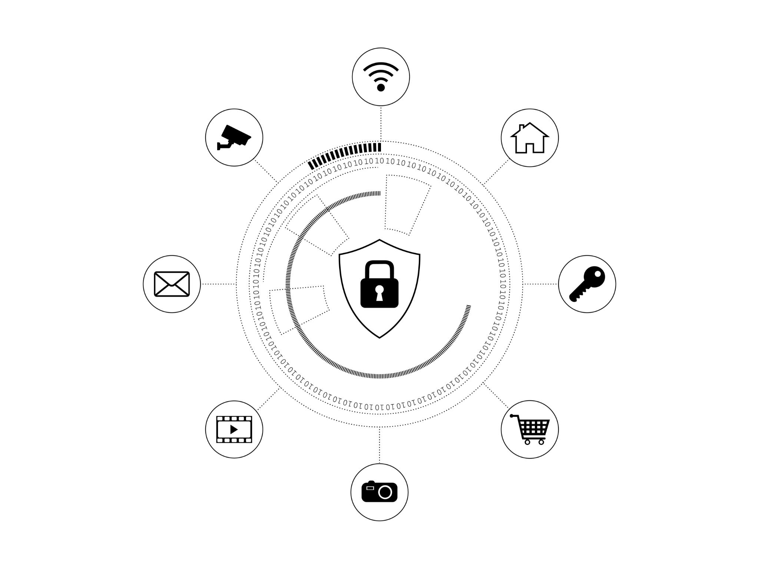
Use Cases and Examples
Secure Application Access
IDaaS provides secure access to various applications by ensuring only authorized users can log in and utilize services.
Compliance Management
IDaaS solutions assist organizations in managing compliance with regulations and standards, ensuring data protection and privacy.
User Identity Verification
Identity verification is crucial for IDaaS, helping to authenticate users effectively and prevent unauthorized access.
Notes:
IDaaS can be used for secure access to applications, compliance management, and user identity verification. Providers like Okta and Azure Active Directory offer IDaaS solutions.

Slide 26
Advantages and Disadvantages
Improved Security
One of the main advantages of IDaaS is enhanced security protocols that protect user data and identity.
Streamlined User Management
IDaaS offers centralized user management, simplifying user provisioning and de-provisioning processes.
Reduced IT Overhead
By outsourcing identity management, organizations can significantly reduce their IT operational costs and overhead.
Integration Challenges
One disadvantage of IDaaS can be the challenges faced while integrating with existing systems and applications.
Potential Vendor Lock-in
Relying on a single IDaaS provider may lead to potential vendor lock-in, limiting flexibility and options.
Notes:
IDaaS advantages include improved security, streamlined user management, and reduced IT overhead. Disadvantages may involve integration challenges and potential vendor lock-in.

Slide 27
Conclusion
Importance of Cloud Computing
Understanding cloud computing is critical for businesses aiming to leverage technological advancements and improve operations.
Service Models Explained
IaaS, PaaS, SaaS, and IDaaS are essential service models that provide flexible solutions for diverse business needs.
Benefits of Adoption
Embracing these service models enhances agility, scalability, and fosters innovation within organizations.
Notes:
Understanding cloud computing and its service models is essential for leveraging technology effectively. By embracing IaaS, PaaS, SaaS, and IDaaS, businesses can enhance their agility, scalability, and innovation.

